Slide 1


Students Social Media Usage & Mental Health Analytics
By: F. O. ADEBAYO

Slide 2
INTRODUCTION
Social media has become an essential part of students' academic and social lives
While it enhances communication and learning, excessive use may affect students' mental health, sleep, and academic performance
This study aims to analyze these relationships using data visualization techniques in Microsoft Power BI

Slide 3
Problem Statement
The growing use of social media among students has raised concerns about its impact on mental health and academic performance
However, there is limited data-driven evidence to explain these effects
Hence, this project analyses students’ data, to provide insights that support healthier digital habits and informed decision-making

Slide 4
OBJECTIVES
To analyze relationships between students' social media usage and mental health
To examine relationships between lifestyle variables and mental health
To develop an interactive dashboard that supports evidence-based decision-making

Slide 5
RESEARCH QUESTIONS
Which social media platforms are the most and least used by students?
What are the most common purposes of social media use?
Is there a relationship between daily social media usage and daily phone unlocks and mental health score?
How does daily social media usage affect students' study hours?
How does physical activity and sleep hours per night influence students' stress levels and mental health?
Which groups of students experience the highest and lowest stress levels based on gender, academic level, or country?

Slide 6
METHODOLODY Dataset & Preparation
Dataset: Student demographics, usage, lifestyle, mental health
Tool: Microsoft Power BI
Variables: Gender, Country, Academic Level, Usage Hours, Unlocks, Sleep, Study, Physical Activity, Stress Level, Mental Health Score
Cleaned missing values, verified types, created age bins/measures.

Slide 7
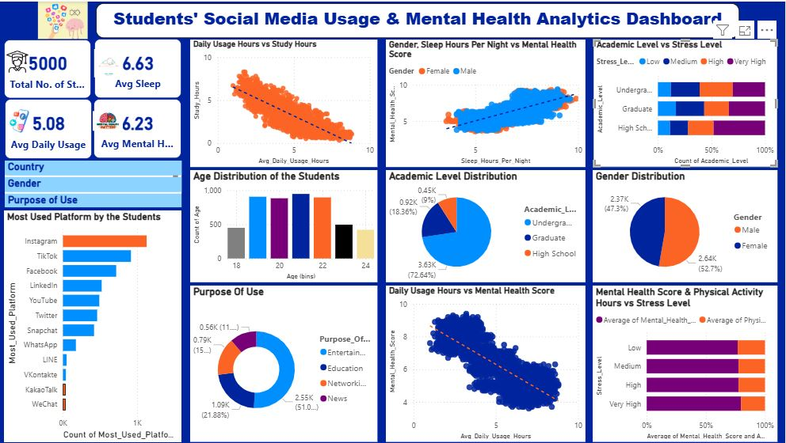
Results of analysis Dashboard overview

Slide 8
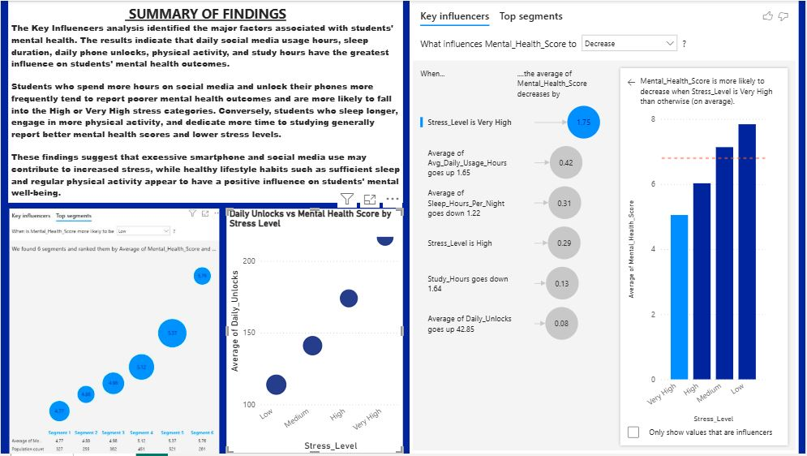
Results of analysis Dashboard overview (Cont’d)

Slide 9
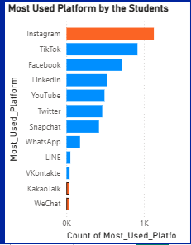
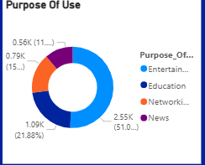
Key Findings RESEARCH ANSWERS
R1: Which social media platforms are the most and least used by students?
R2: What are the most common purposes of social media use?

Slide 10
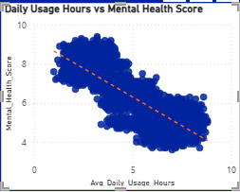
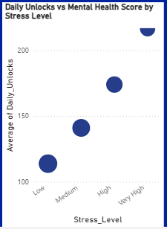
Key Findings RESEARCH ANSWERS
R3: Is there a relationship between daily social media usage and daily phone unlocks and mental health score?

Slide 11
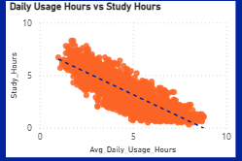
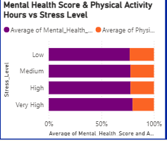
Key Findings RESEARCH ANSWERS
R4: How does daily social media usage affect students' study hours?
R5: How does physical activity & sleep hour per night influence students' stress levels?

Slide 12
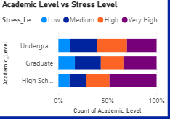
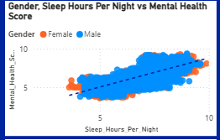
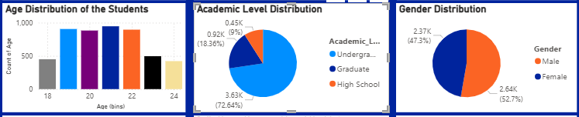
Key Findings RESEARCH ANSWERS
R6: Which groups of students experience the highest and lowest stress levels based on gender, academic level, or country?

Slide 13
Recommendations
Promote healthy digital habits
Encourage sleep and exercise
Provide mental health awareness and counselling
Continue monitoring student wellbeing

Slide 14
Conclusion
An interactive analysis was conducted on the students’ social media usage data. The resulting PowerBI dashboard effectively highlights the relationship between students' digital behaviour and mental health, providing valuable information that can support better decision-making by students, educators, and policymakers.

